Slide 1
Discussion today
Over the next two class periods we will be designing a ring resonator based 2-channel wavelength division multiplexing (WDM) optical link.
Today we will look at the following:
  Discuss modulation of light
  Review ring resonator and how we can use a ring resonator to modulate light
  Introduce Lumerical DEVICE, an optoelectronic charge transport solver
  Simulate carrier density in ring resonator modulator as a function of applied bias
  Simulate effective index of ring resonator modulator waveguide as a function of applied bias.

Slide 2
(Amplitude) modulation of light
intensity
intensity
Modulator
Light out
CW Laser
voltage
Data in

Slide 3

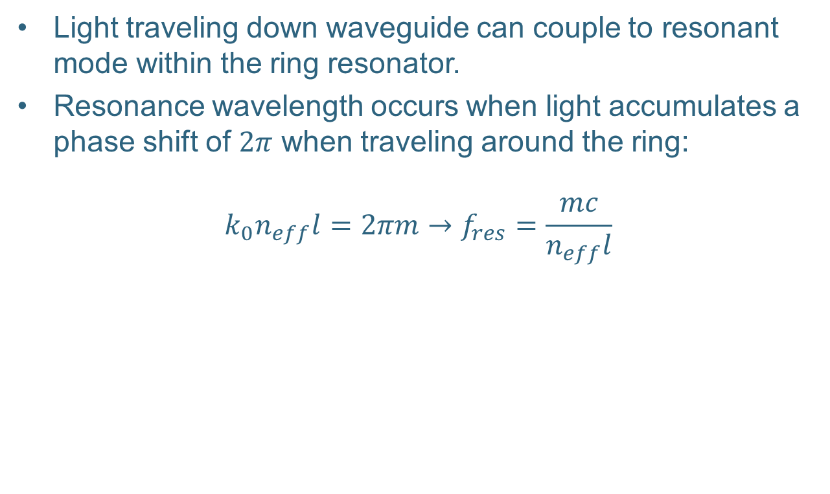

Ring resonator
Light traveling down waveguide can couple to resonant mode within the ring resonator.
Resonance wavelength occurs when light accumulates a phase shift of $2π$ when traveling around the ring:
$$k_{0}n_{eff}l=2πm→f_{res}=\frac{mc}{n_{eff}l}$$
$$t$$
Waveguide
$$κ$$
Ring Resonator

Slide 4
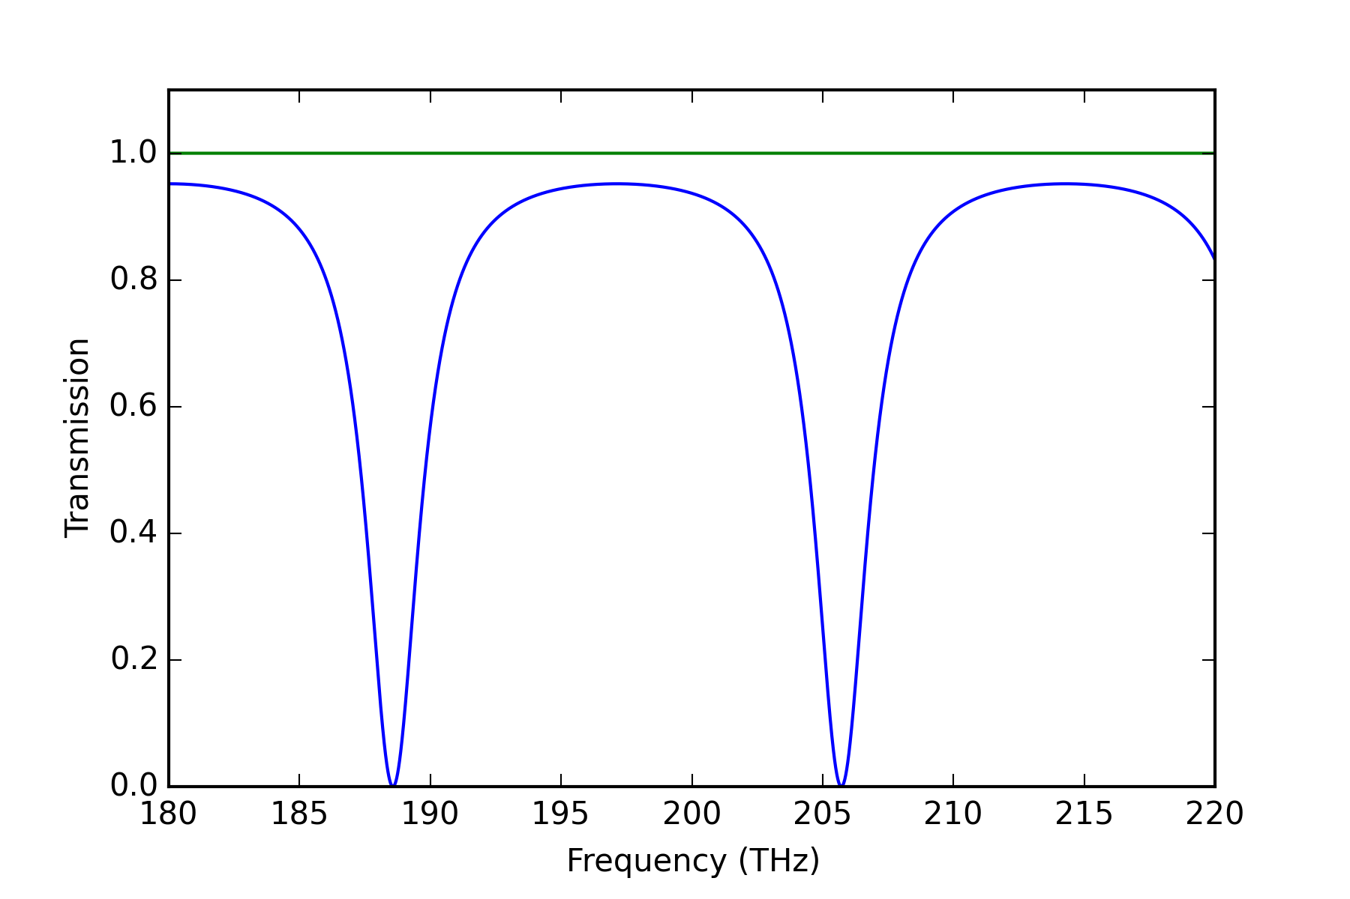
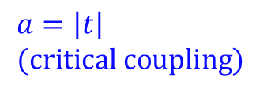
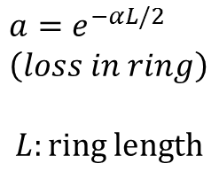
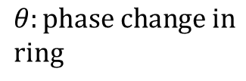
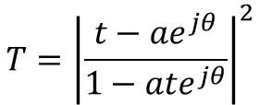
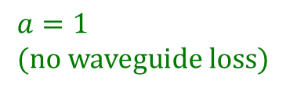
Power transmission
$$a=1 \\ (no waveguide loss)$$
$$T={\left|\frac{t−ae^{jθ}}{1−ate^{jθ}}\right|}^{2}$$
$$θ:phase change in \\ ring$$
$$a=\left|t\right| \\ (critical coupling)$$
$$a=e^{−αL/2} \\ \left(loss in ring\right)$$
$$L:ring length$$

Slide 5
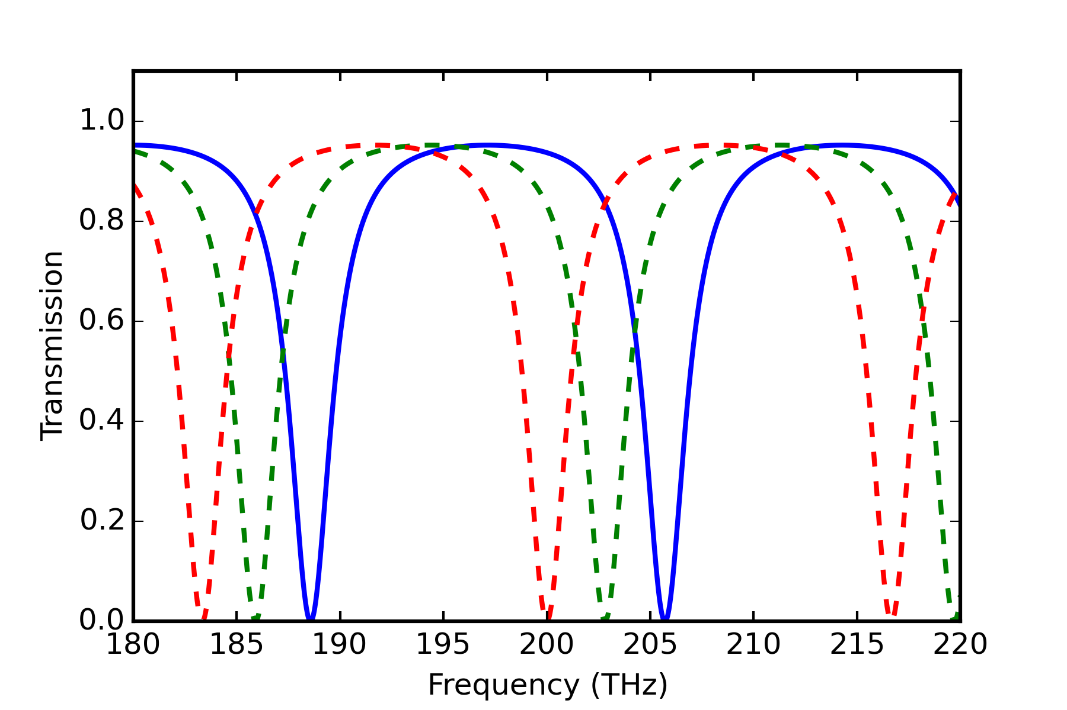




Modulation of light with ring resonator
Recall $f_{res}=\frac{mc}{n_{eff}l}$
If we have a means to change the effective index on-demand we can shift the resonance frequency of the ring resonator.
$$n_{eff}=3.5$$
$$n_{eff}=3.55$$
$n_{eff}=3.$6

Slide 6




Modulation of light with ring resonator
$f_{res}=\frac{mc}{n_{eff}l}$
$Δf_{res}=\frac{∂f_{res}}{∂n_{eff}}Δn_{eff}=\frac{mc}{l}⋅−n_{eff}^{−2}Δn_{eff}=−\frac{f_{res}}{n_{eff}}Δn_{eff}$
$⇒\frac{Δf_{res}}{f_{res}}=−\frac{Δn_{eff}}{n_{eff}}$
$$n_{eff}=3.5$$
$$n_{eff}=3.55$$
$n_{eff}=3.$6

Slide 7
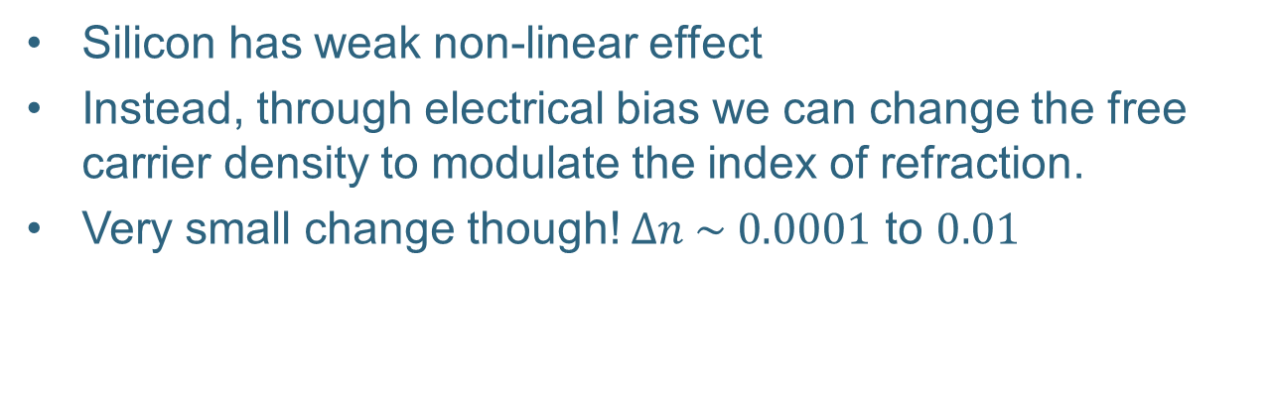
Refractive index of silicon depends on free carrier density
Silicon has weak non-linear effect
Instead, through electrical bias we can change the free carrier density to modulate the index of refraction.
Very small change though! $Δn \sim 0.0001$ to $0.01$
*R. A. Soref and B. R. Bennett, SPIE Integr. Opt. Circuit Eng. 704, 32 (1987)

Slide 8
Depletion width modulation in pn junction
Depletion region
Depletion region
p-type
junction
n-type
p-type
junction
n-type
+
-
+
-
V=0
V<0

Slide 9
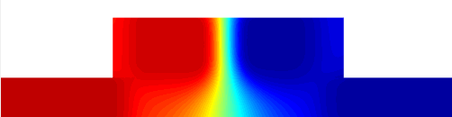
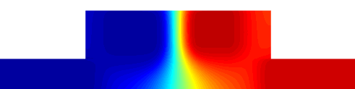
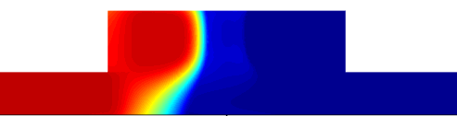
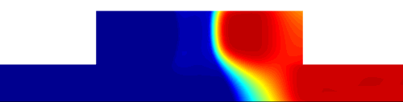
pn junction ring resonator
Output
Cross section of ring waveguide
n-contact
n
p
No applied bias (V=0)
p-contact
V
hole concentration
electron concentration
Reverse bias
V < 0 → carriers are swept out of junction
ring
Input
hole concentration
electron concentration

Slide 10
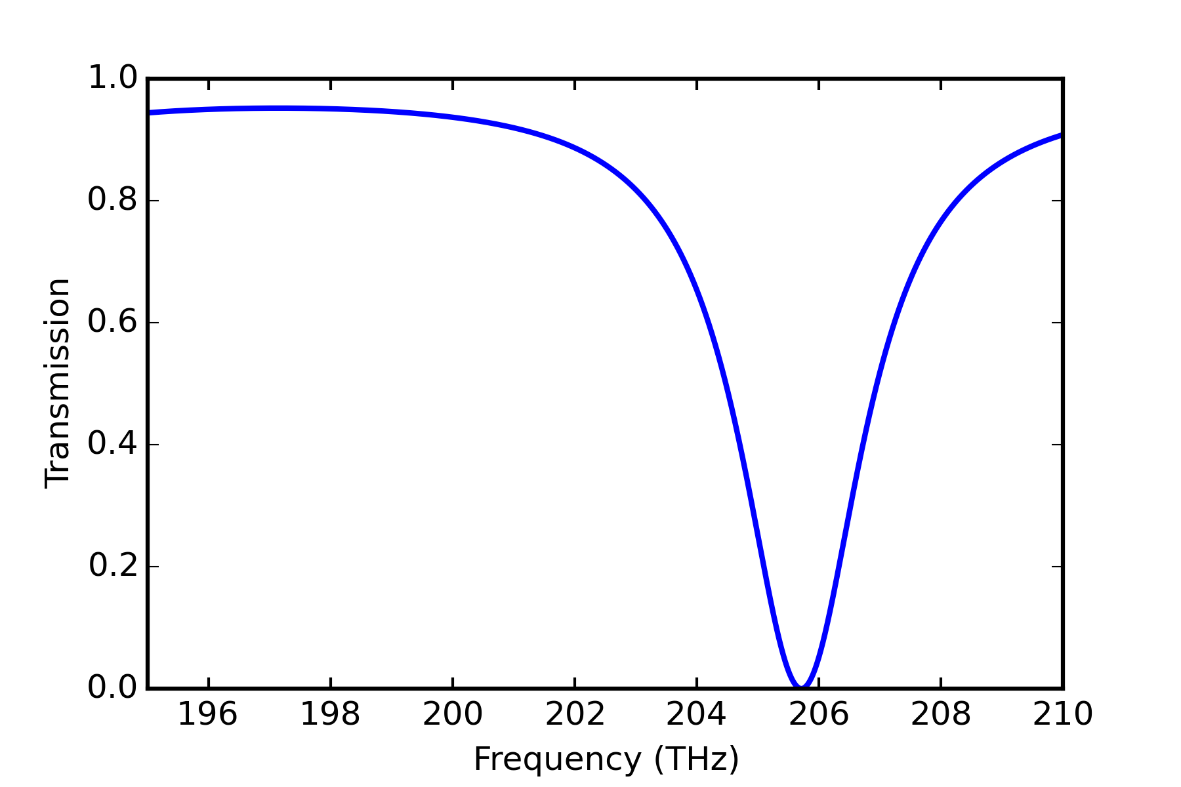

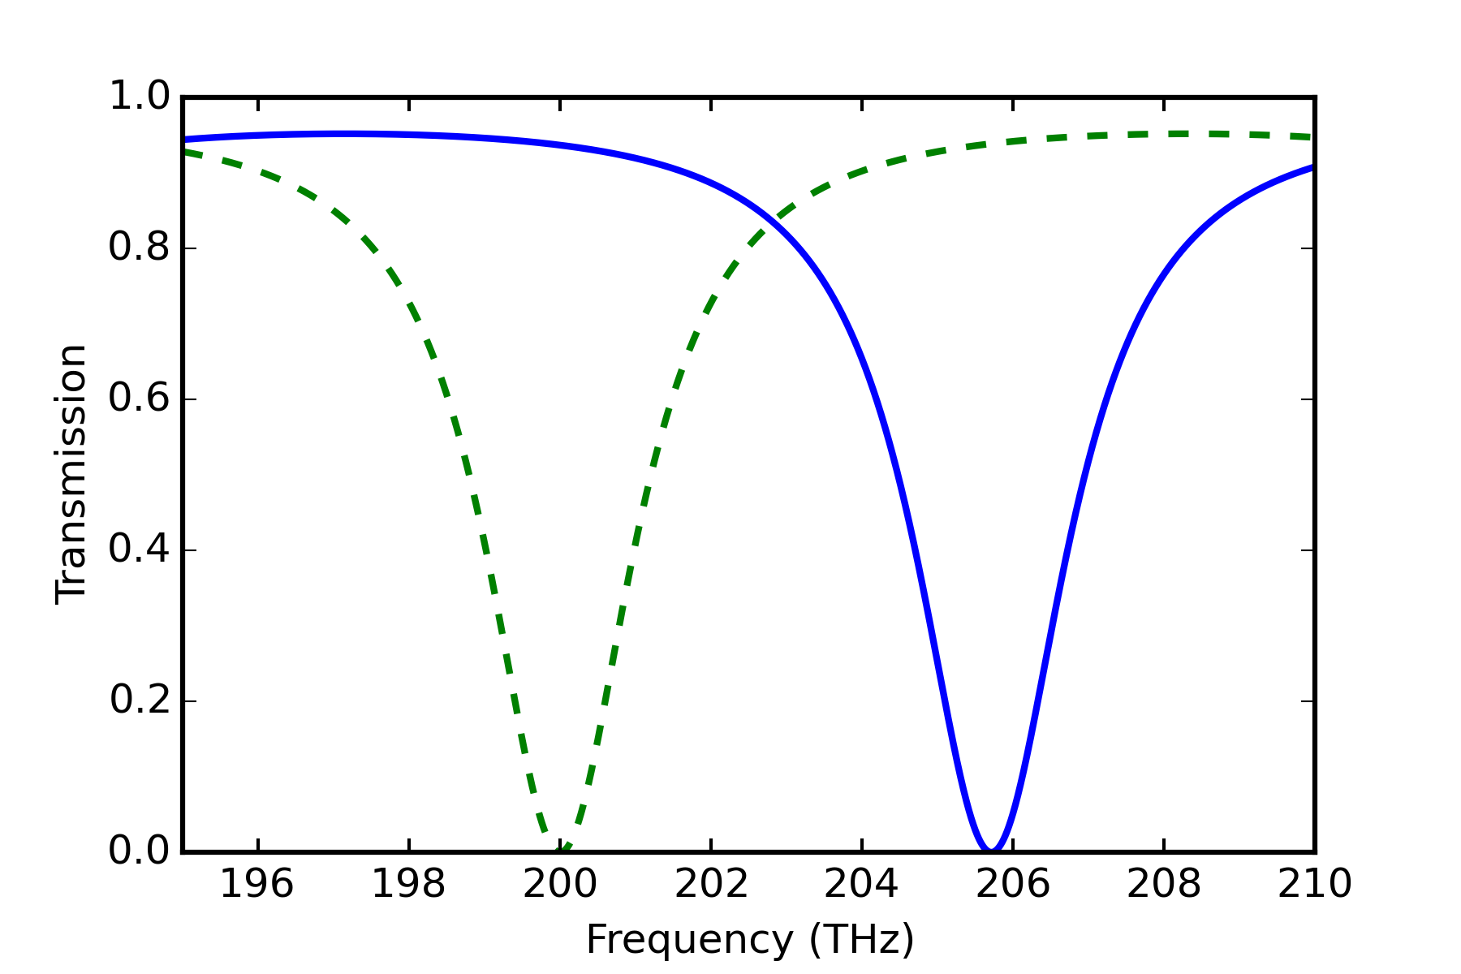
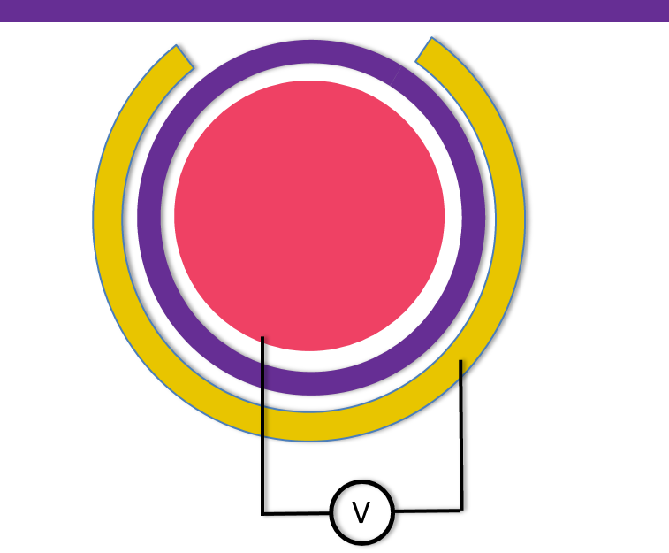
On-off keying modulation
Laser frequency
Input
Output = 0
x
n-contact
p-contact
ring
Frequency
Laser frequency
Input
Output = 1
n-contact
p-contact
Apply voltage
ring
Frequency

Slide 11
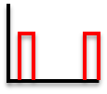
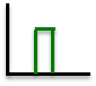
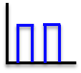
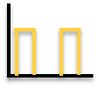
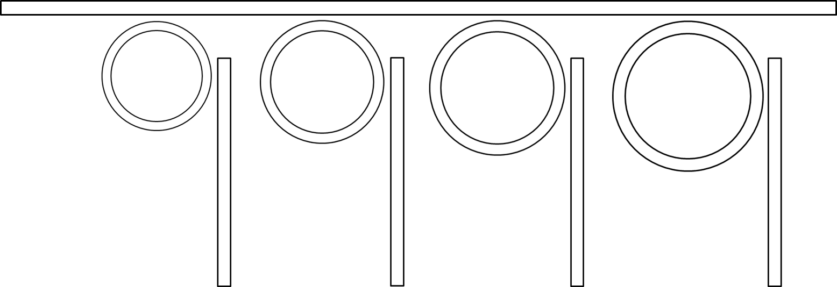
















4-Channel WDM
Transmitter
$$λ_{1}$$
$$λ_{1}$$
$$λ_{2}$$
$$λ_{3}$$
$$λ_{4}$$
$$λ_{2}$$
fiber
$$λ_{3}$$
$$λ_{4}$$
Data in
CW lasers
$$λ_{1}$$
$$λ_{2}$$
$$λ_{3}$$
$$λ_{4}$$
Receiver
fiber
$$λ_{1}$$
$$λ_{2}$$
$$λ_{3}$$
$$λ_{4}$$

Slide 12
Simulation strategy
Use DEVICE to calculate carrier density in the ring waveguide as a function of applied voltage bias
Import carrier density into MODE and calculate effective index as a function of applied bias
Import effective index as function of voltage into INTERCONNECT and design ring resonator dimensions using analytical model
Simulate entire optical link using INTERCONNECT

Slide 13
Simple pn-junction simulation
Open the file pn_junction.ldev
You will see the geometry of a 10 um thick silicon slab contacted on either side by aluminum.
Geometry can be created in DEVICE just as you would in FDTD or MODE
In the next steps we will add p and n-type doping to create a pn-junction within the silicon slab.

Slide 14
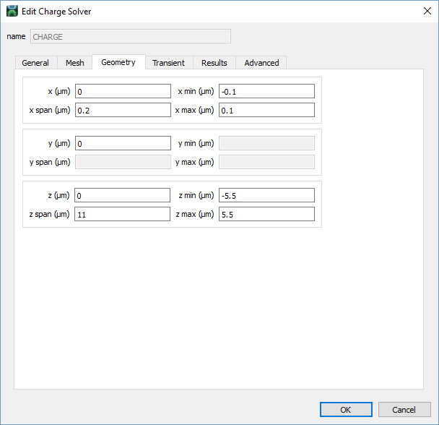
Create simulation region
Create simulation region by clicking Simulation → Charge transport solver
Click Edit object

Slide 15
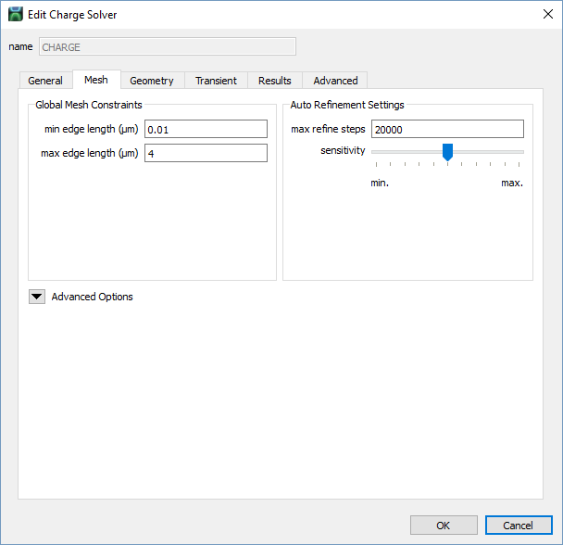
Create simulation region

Slide 16
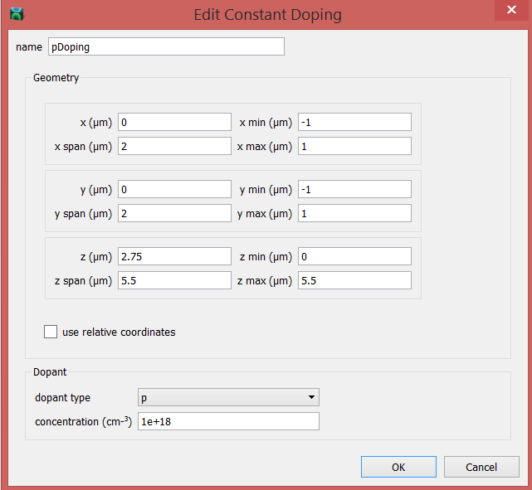
Create p-type doping
Click Doping → Constant Doping
Edit
Click OK

Slide 17
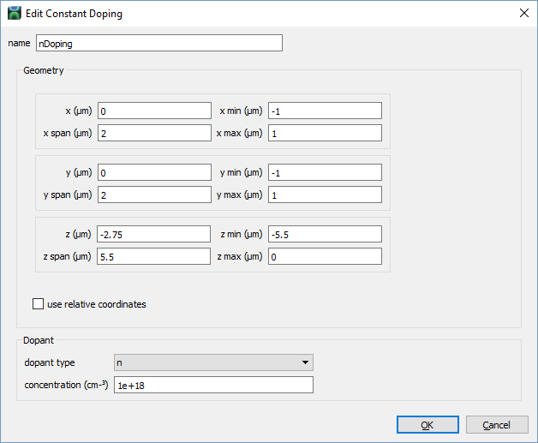
Create n-type doping
Click Doping → Constant Doping
Edit
Click OK

Slide 18
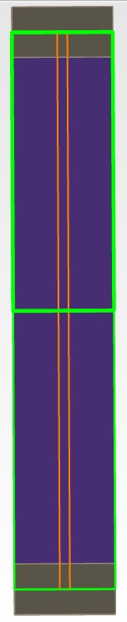
pn junction
Contact (Al)
p-type
n-type
Contact (Al)

Slide 19
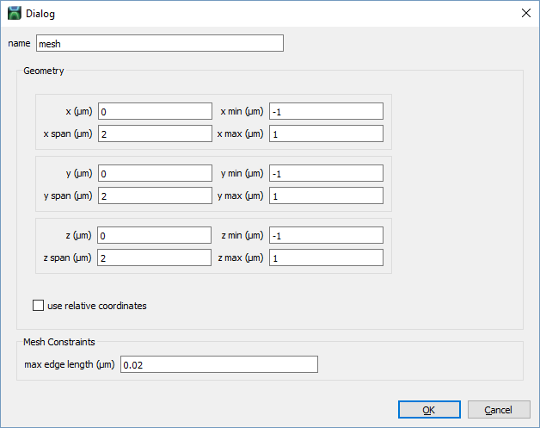
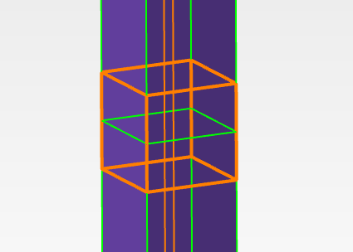
Add mesh refinement at junction
Click Constraints → Charge Transport Solver Mesh Constraint
Click Edit Object

Slide 20
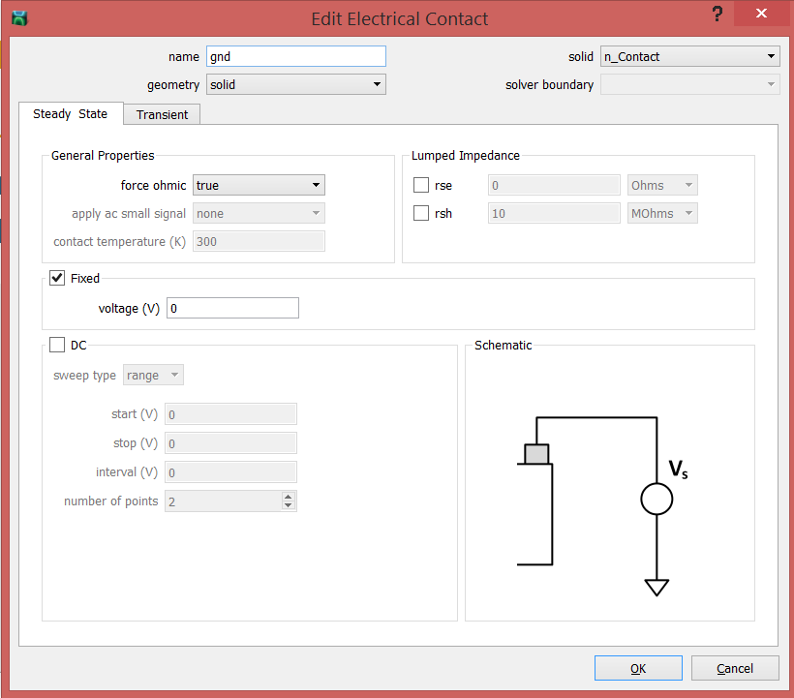
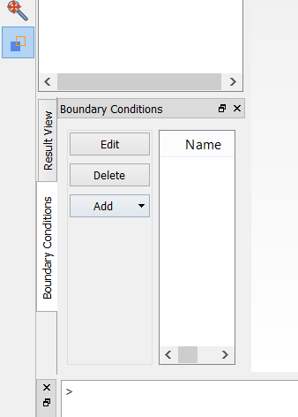
Set contact boundary conditions
Click Boundary conditions → Add → electrical contact
Select, click Edit

Slide 21
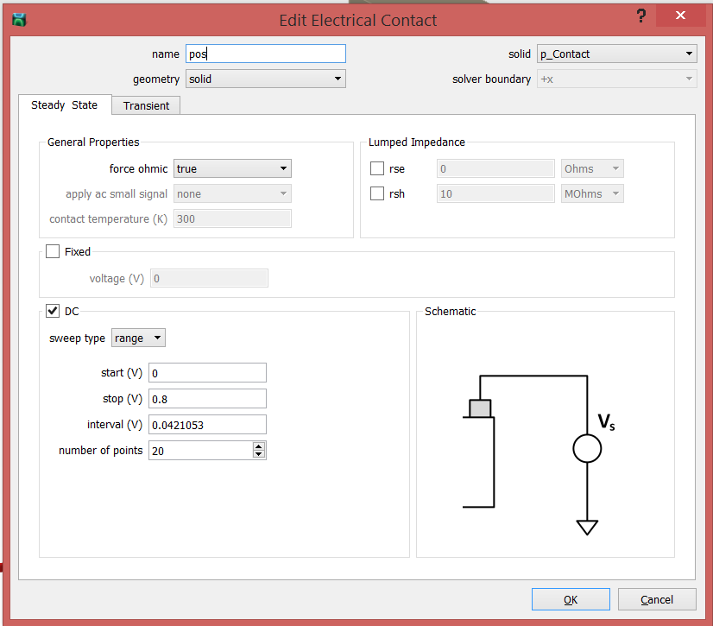
Set contact boundary conditions
Click Boundary conditions → Add → Electrical contact
Select, click Edit

Slide 22
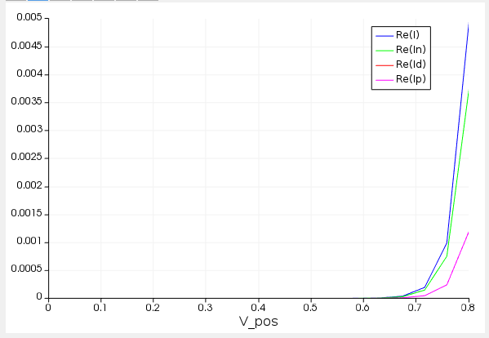
Simulation
Click Run
Right-click CHARGE → Visualize → pos to plot I-V curve
Under Attributes, select Vs and Vc and click Remove, to show only currents
e- current
Displacement current
(none since DC simulation)
p+ current

Slide 23
Simulation
We can plot other data such as quasi-fermi levels, carrier concentration, etc. but will not explore that further here.

Slide 24
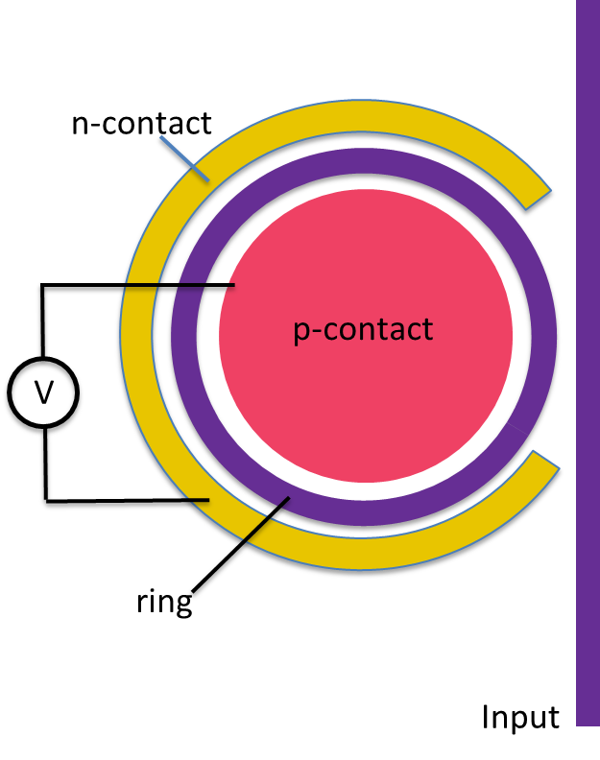
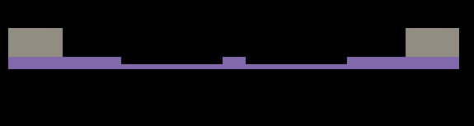
pn junction ring resonator
Open the file ring_resonator_pn_junction.ldev.
You will see the geometry and doping profile used to simulate the carrier density as a function of applied bias for a pn junction ring resonator
Silicon rib waveguide
n-contact
p-contact
n-type
n
p
p-type
pn junction

Slide 25
pn junction ring resonator
A monitor has already been created that will save the carrier density as a function of applied bias.
Run simulation
Carrier density information will be saved to the file mod_carriers.mat

Slide 26
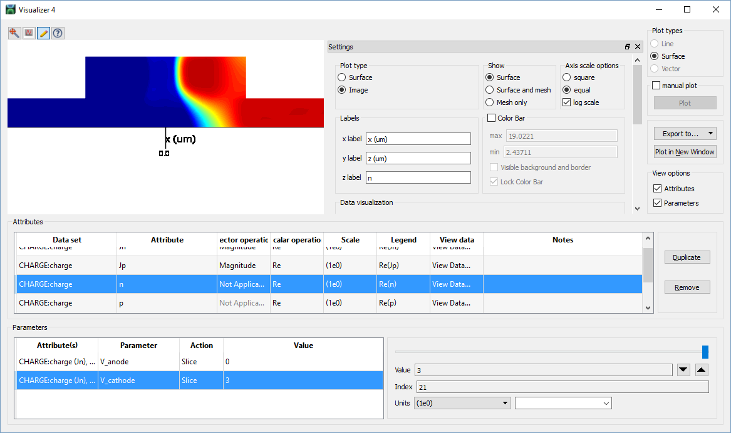
pn junction ring resonator
Right-click CHARGE → Visualize → charge
Scroll wheel to zoom in

Slide 27
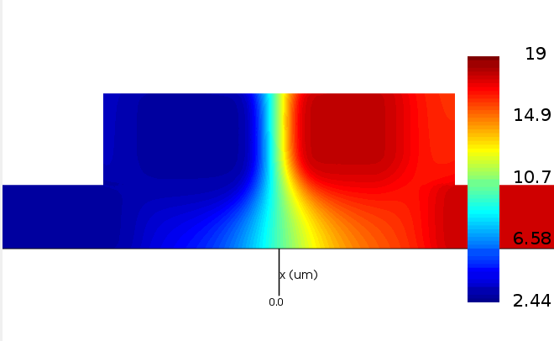
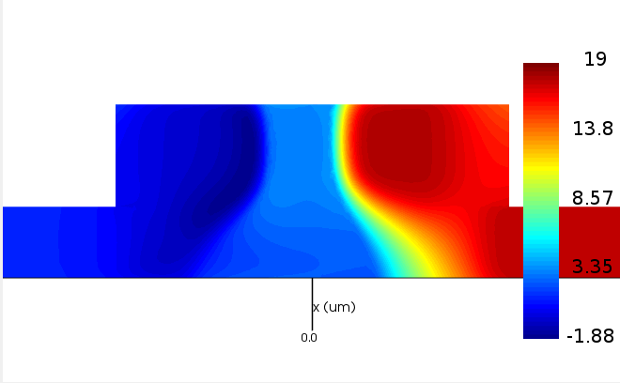
pn junction ring resonator
Right-click CHARGE → Visualize → charge
Scroll wheel to zoom in
V_{cathode} = 0 V
V_{cathode} = 3 V

Slide 28
Import carrier density into MODE
Open the file pn_junction_waveguide.lms
You will see the same pn junction waveguide geometry in MODE.
We now need to import the charge density that we just simulated in DEVICE.

Slide 29
Create np density attribute
Click Attributes → np Density
Right-click Edit object.
Click Import Data…
Select mod_carriers.mat

Slide 30
Run simulation
Next we will run a Simulation sweep that will sweep through each of the carrier densities that we measured at each applied voltage
Run the sweep reverse.
Run the script plot_MODE_data.lsf; this will plot two graphs showing the change in effective index for applied voltage and waveguide loss for each applied voltage.

Slide 31
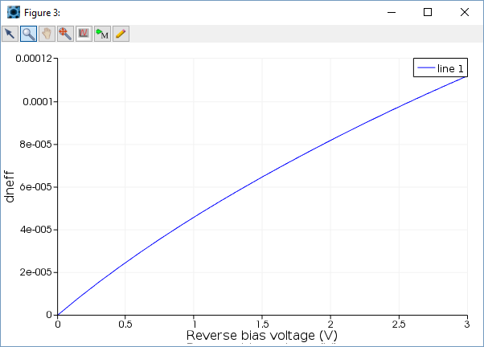
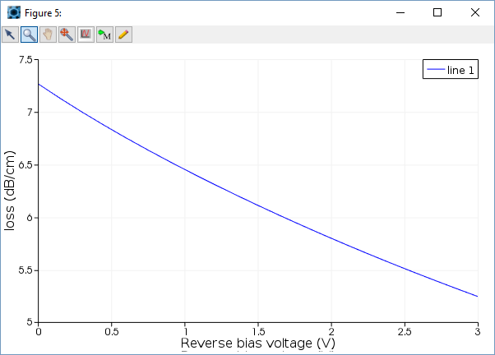
Effective index and loss
Small change in effective index!
Why does loss go down with
increasing reverse bias voltage?

Slide 32
20degree temperature shift gives resonance shift of 1nm

